Slide 1
UCSD Embedded C Assignment 2
By
Hsuankai Chang
hsuankac@umich.edu

Slide 2
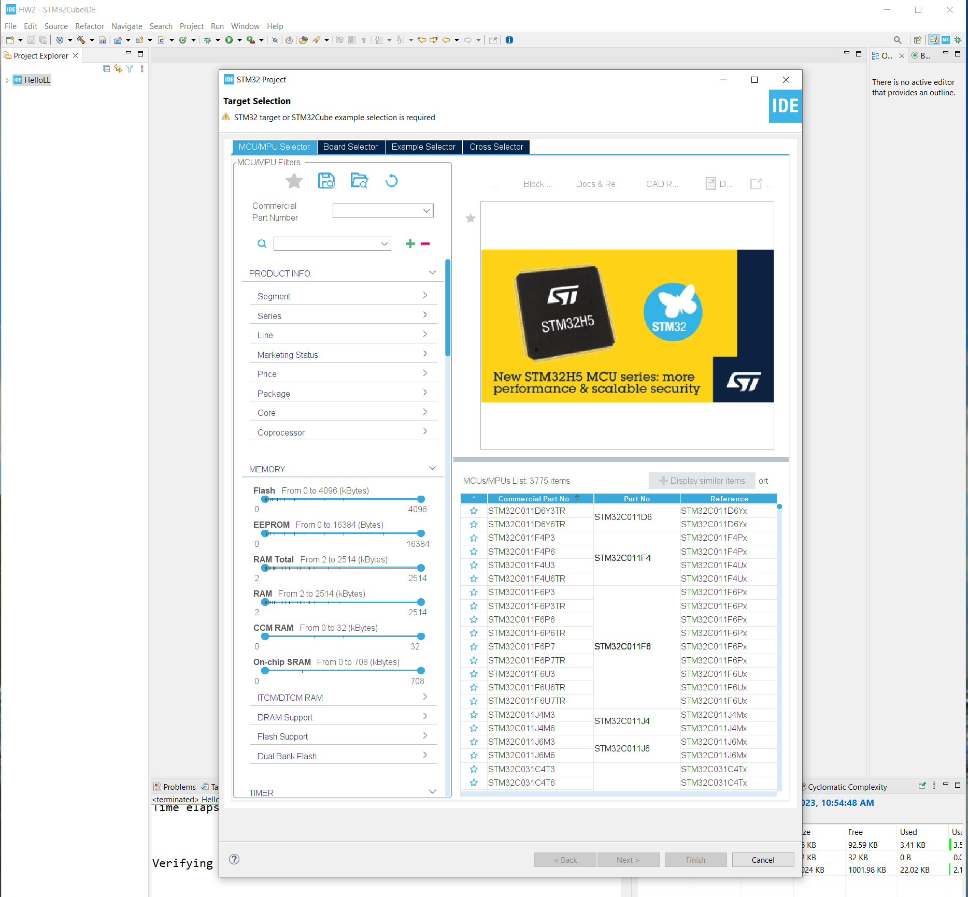
Step 1. Startup STM32CubeIDE and create new STM32 project

Slide 3
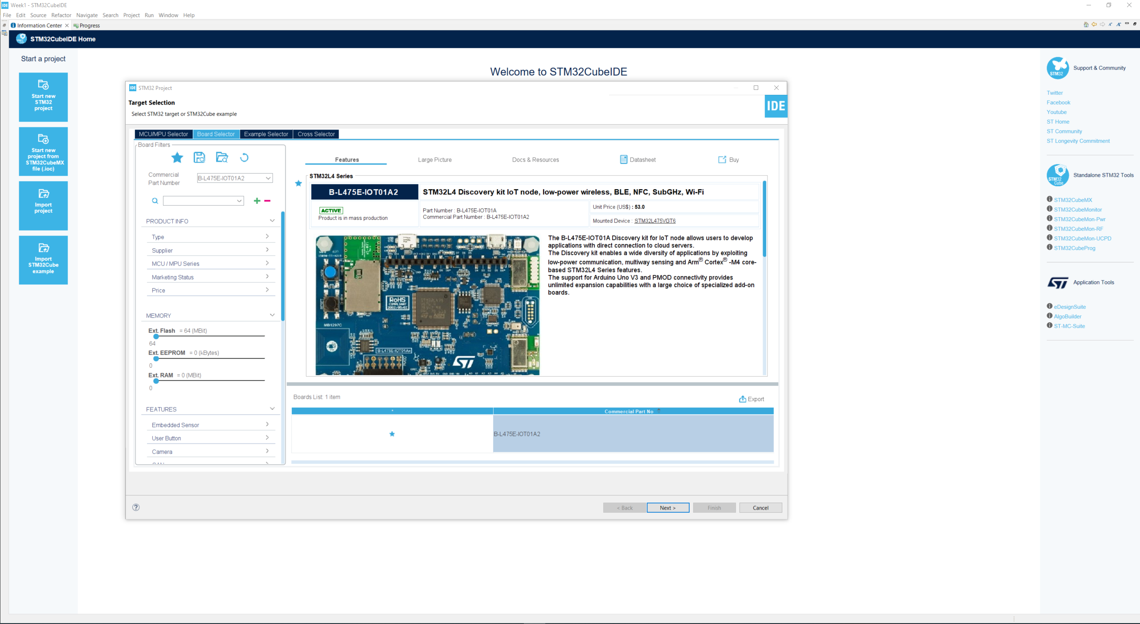
Step 2. Access board selector and type in the board you use, click Next

Slide 4
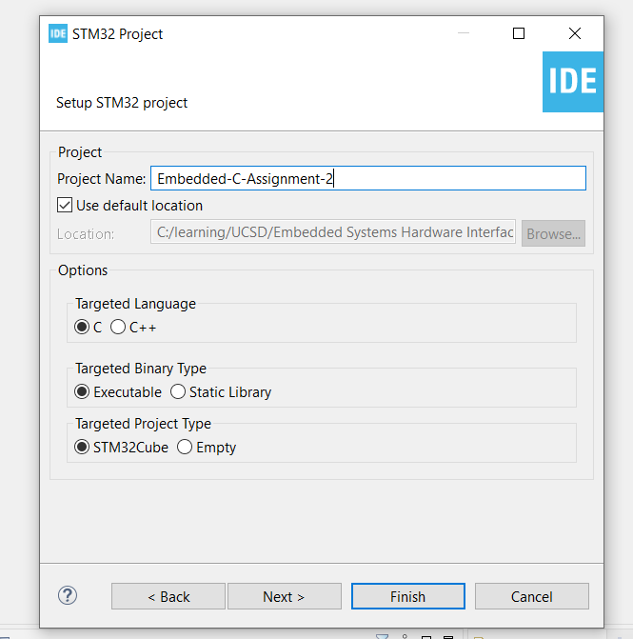
Step 3. Enter the project name then click Next

Slide 5
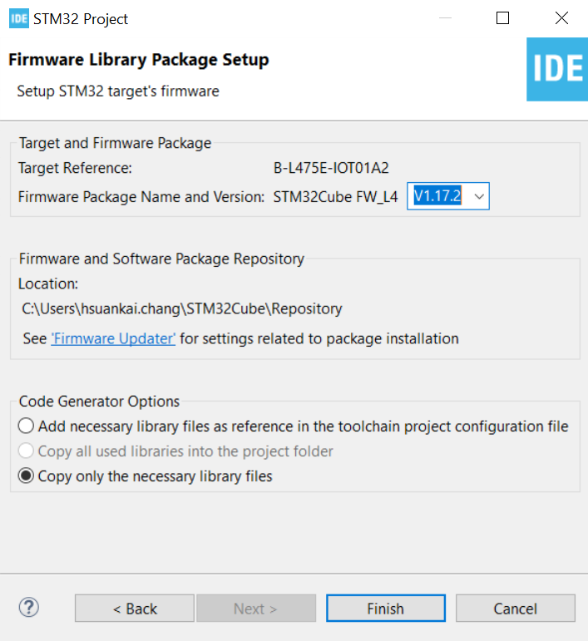
Step 4. See the firmware package name and version

Slide 6
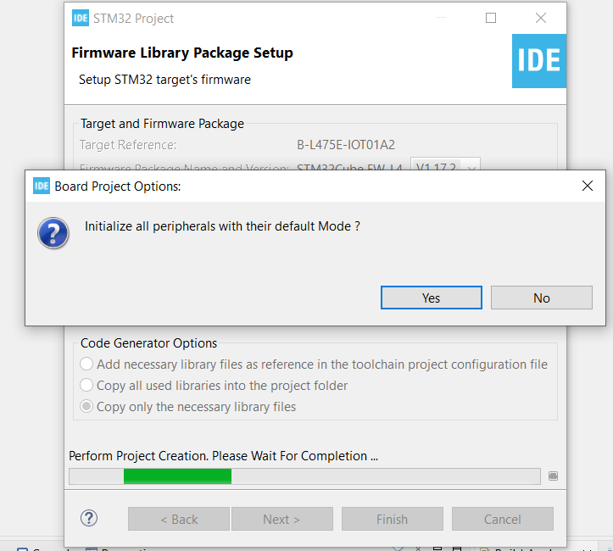
Step 5. Click yes to initialize all peripherals to default

Slide 7
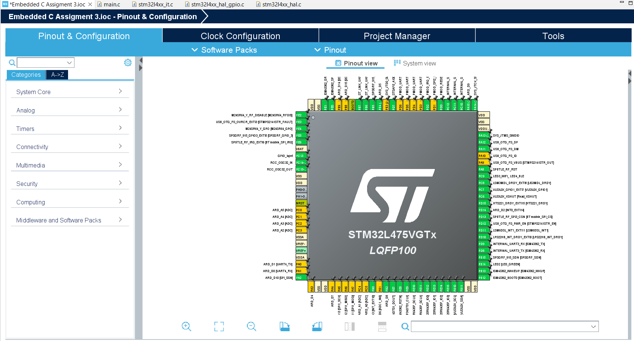
Step 6. When in .ioc file, click Pinout & Configurations

Slide 8
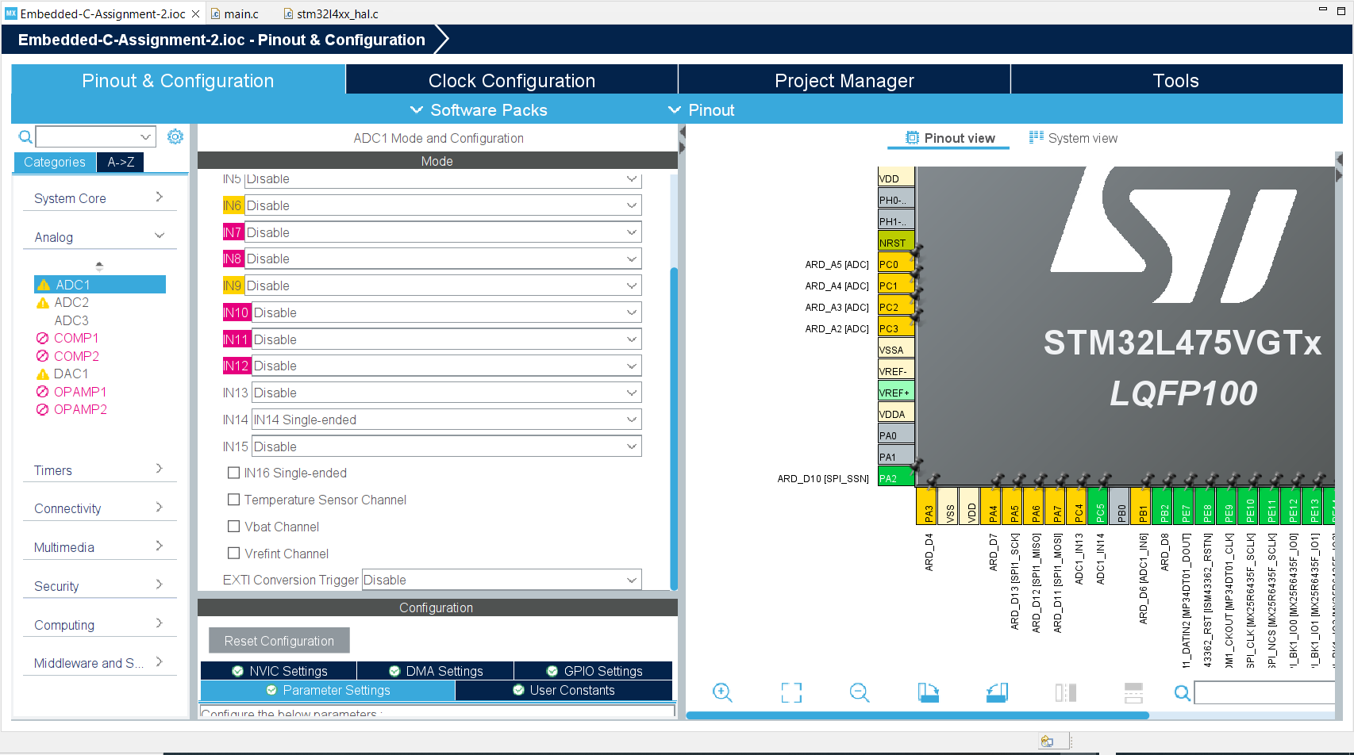
Step 7. User Story 1: Connect ARD-A0 to a 1.5VDC battery and read using ADC Polling mode. Show the output to the console

Slide 9
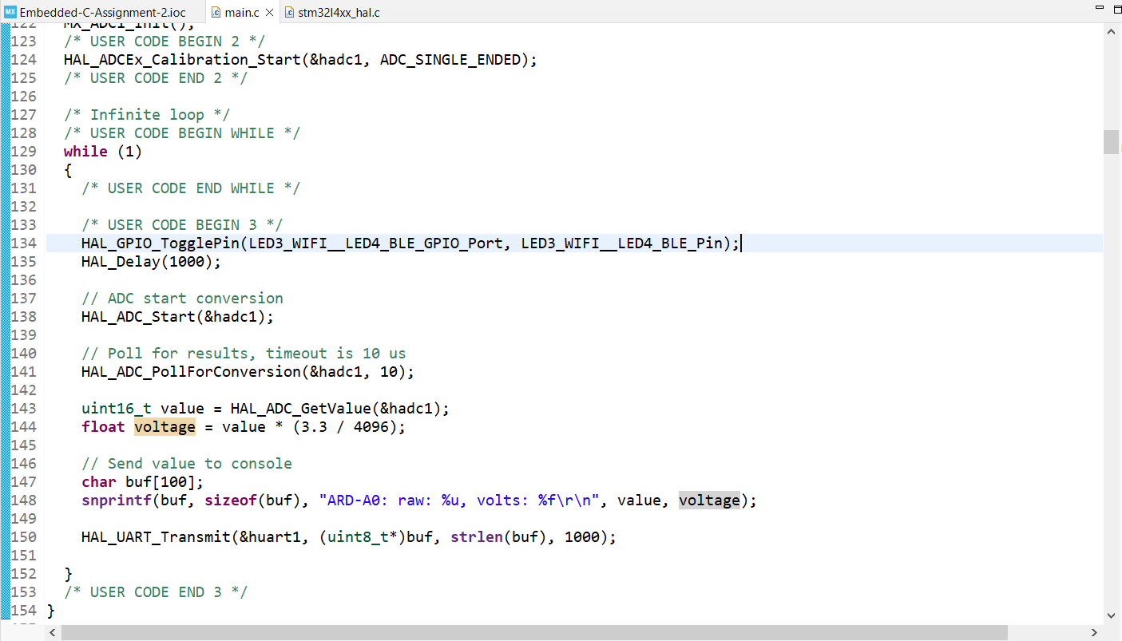
Step 8. Write the polling mode code in main.c file

Slide 10
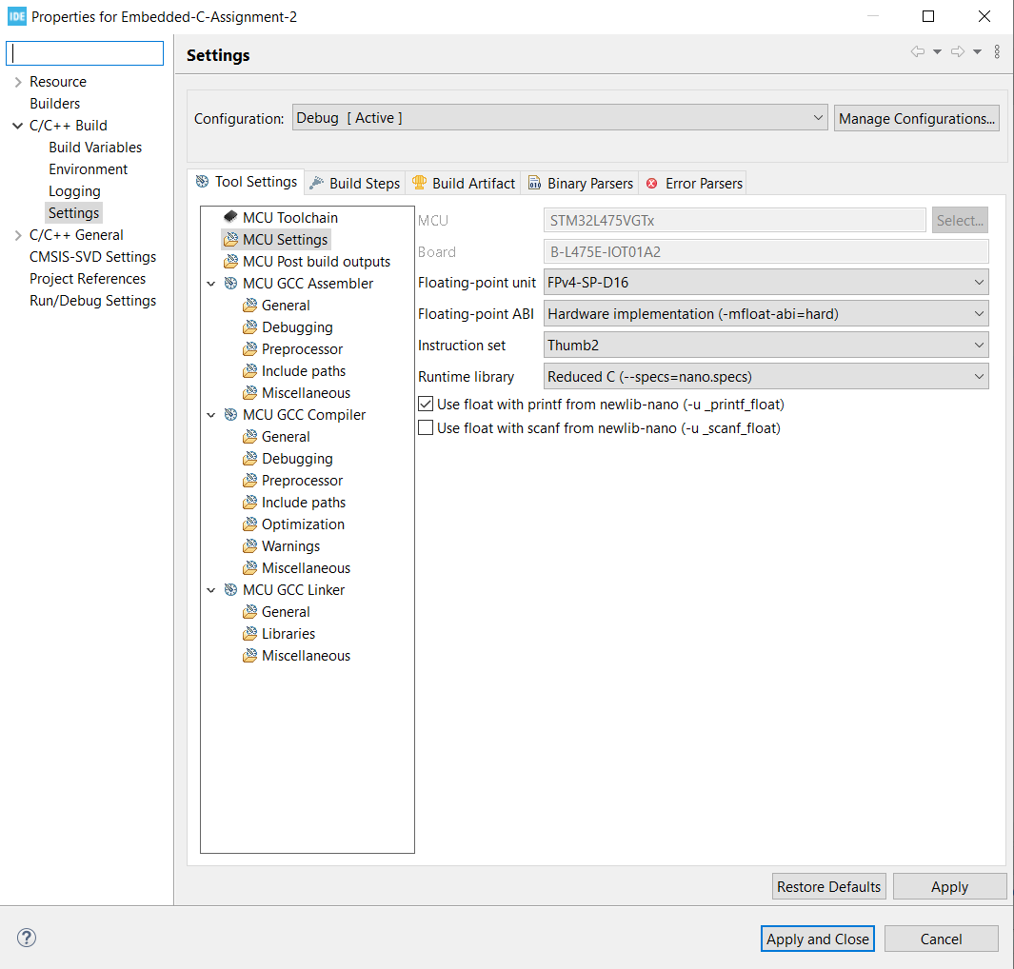
Step 9. Since we are using floating point with printf, go to build setting and enable this flag

Slide 11
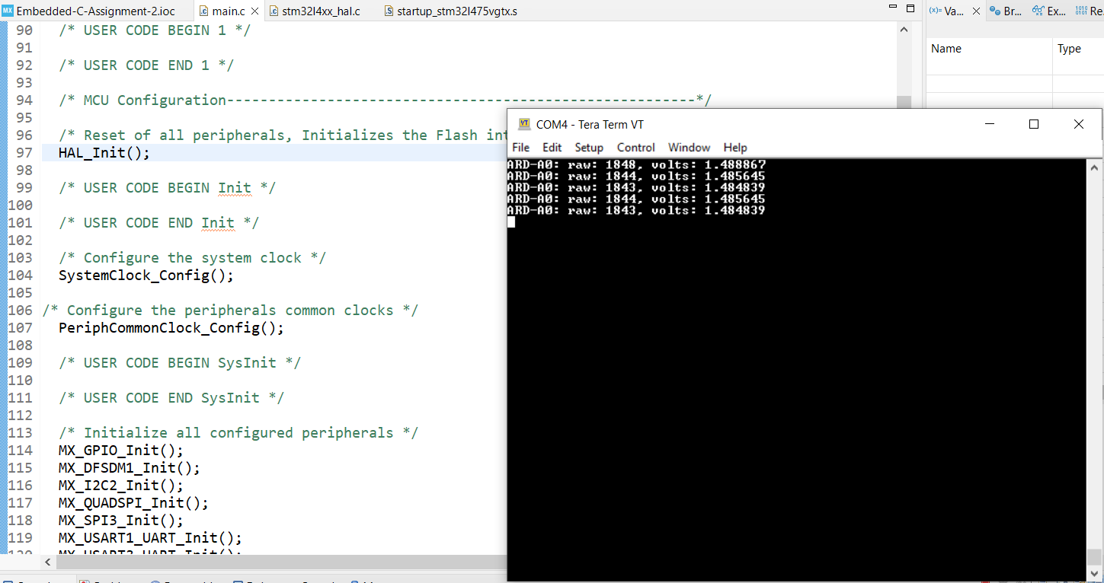
Step 10. Build the debug the code, open tera term and we can see the output is nearly 1.5v on the console

Slide 12
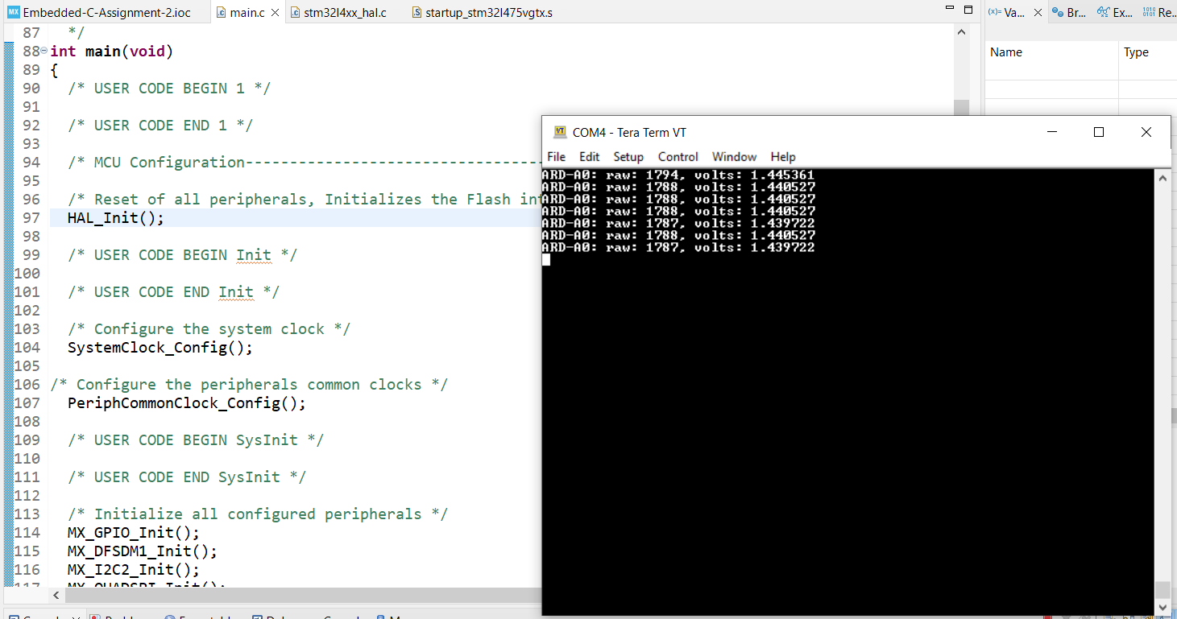
Step 11. Repeat user story 1 without doing calibration for user story 4. Observe that without calibration the value deviate more from 1.5V

Slide 13
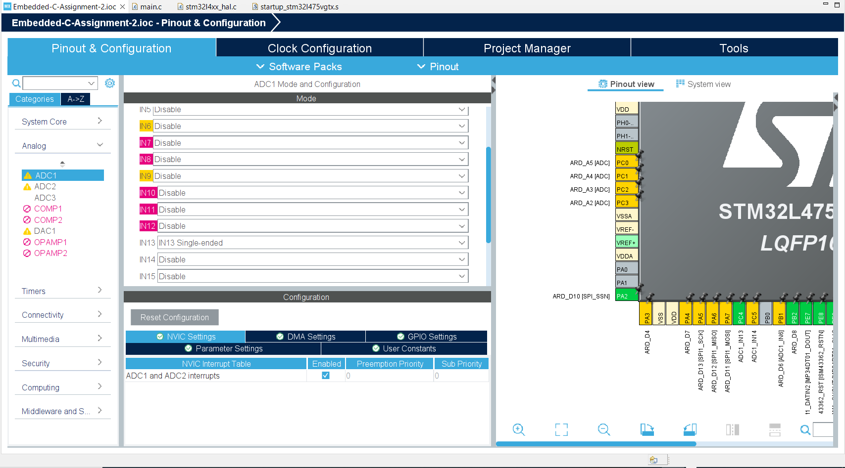
Step 12. User Story 2: Connect ARD-A1 to the same 1.5VDC battery and read using ADC Interrupt mode and send the output to the console

Slide 14
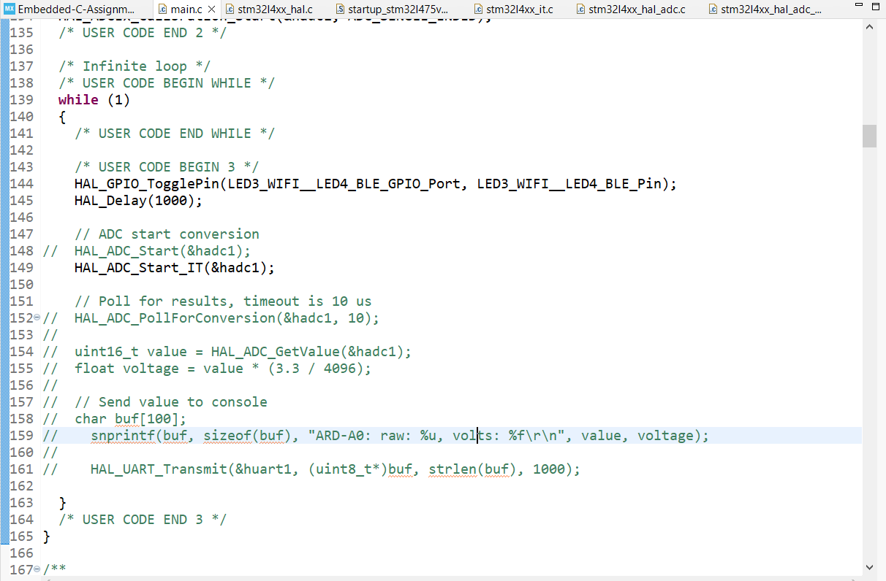
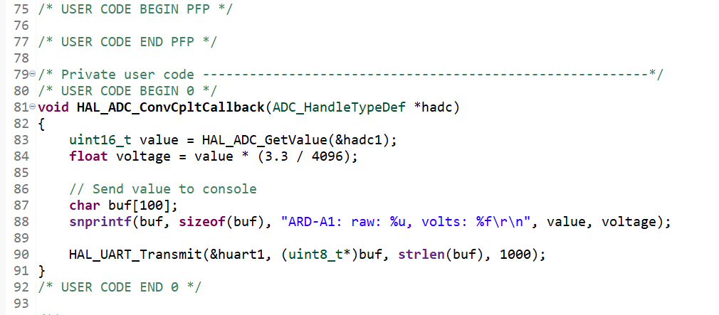
Step 13. Write the interrupt code in main.c file

Slide 15
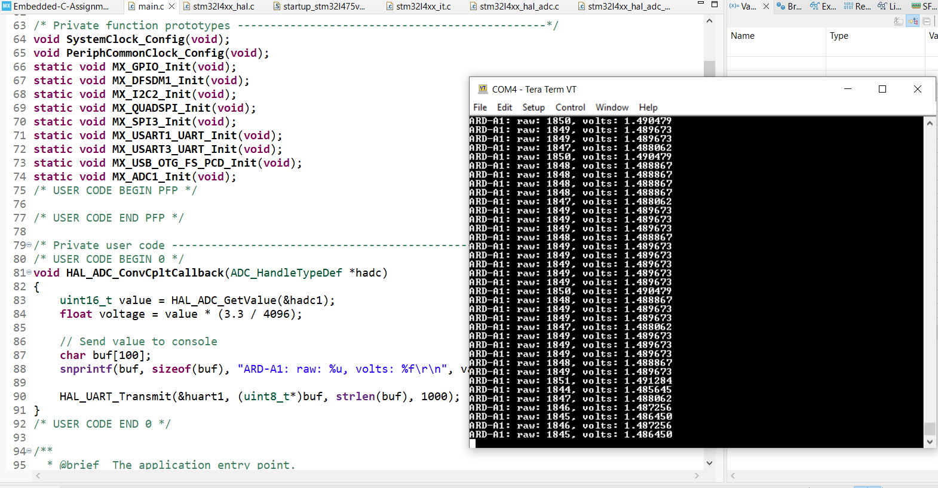
Step 14. Build and debug the code, observe the result on tera term

Slide 16
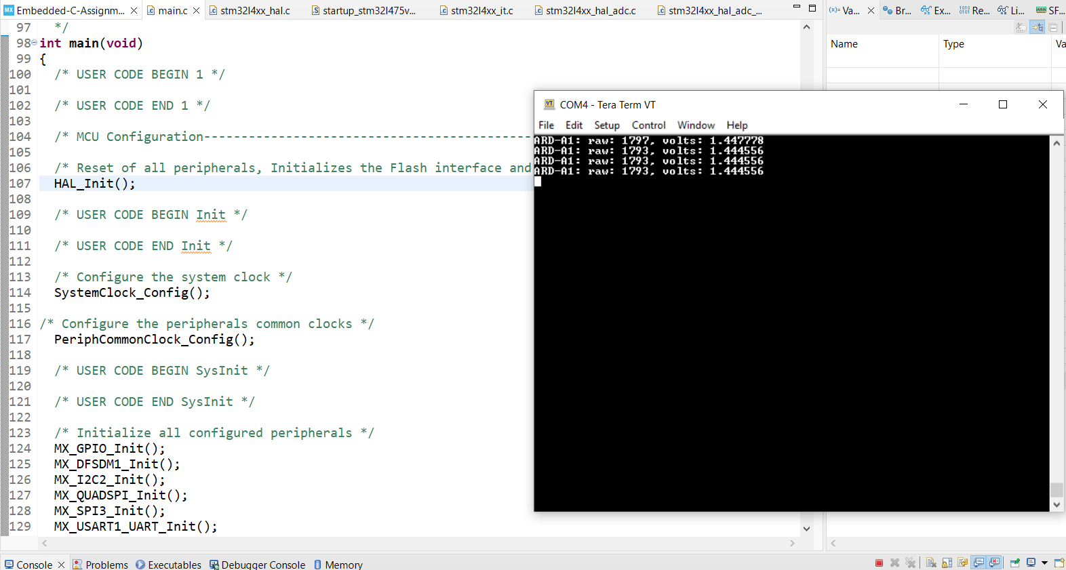
Step 15. Repeat user story 2, without calibration, we can see the result deviates more from 1.5V

Slide 17
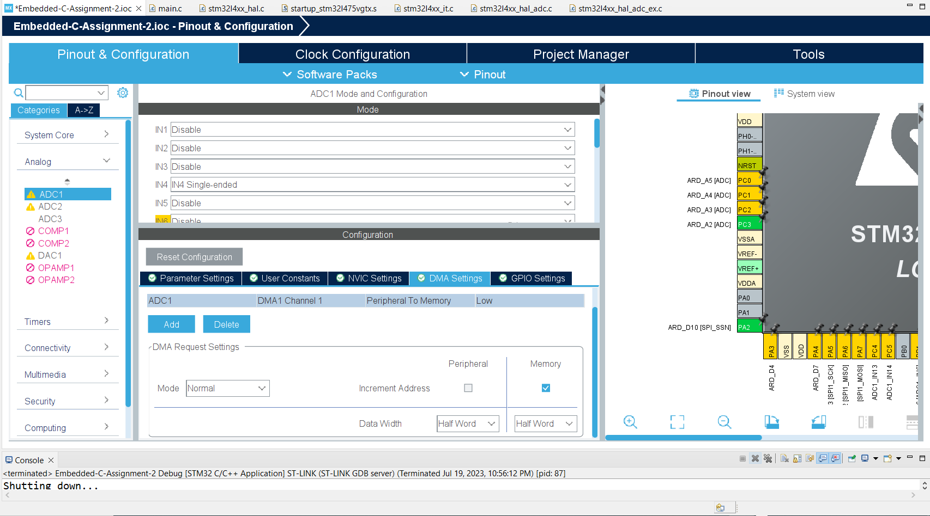
Step 16. User Story 3: Connect ARD-A2 to the same 1.5VDC battery and read using ADC DMA Mode and send the output to the

Slide 18
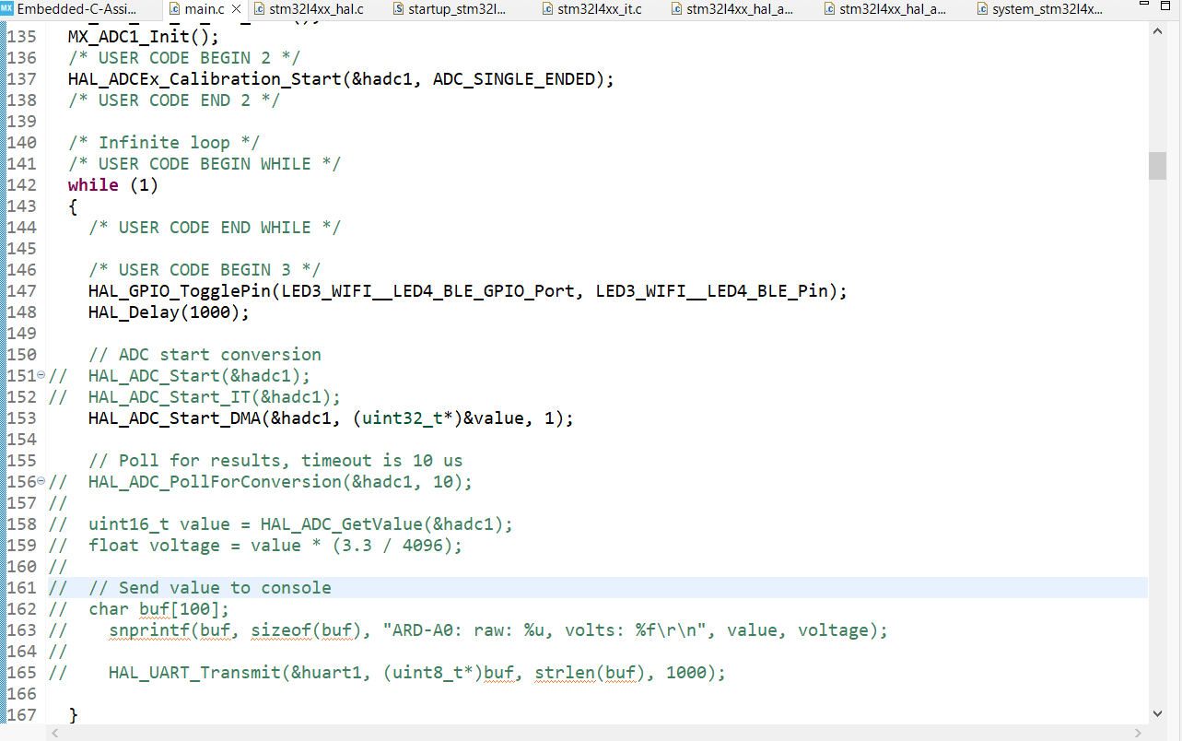
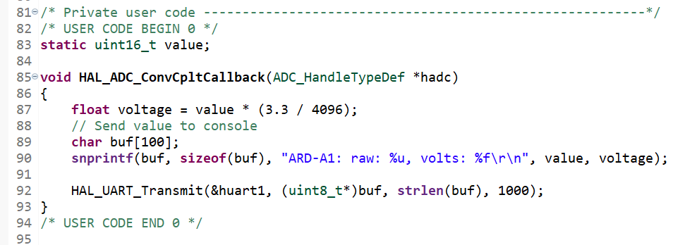
Step 17. Write the DMA code in main.c file

Slide 19
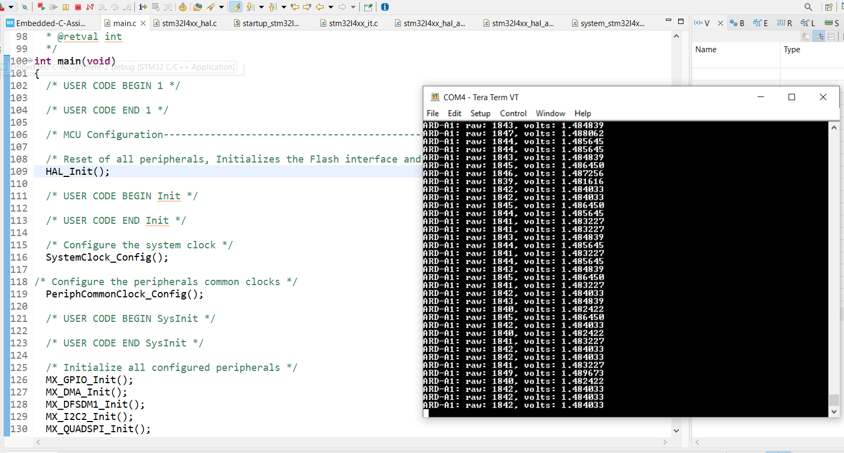
Step 18, Build and debug the code, observe the result on tera term

Slide 20
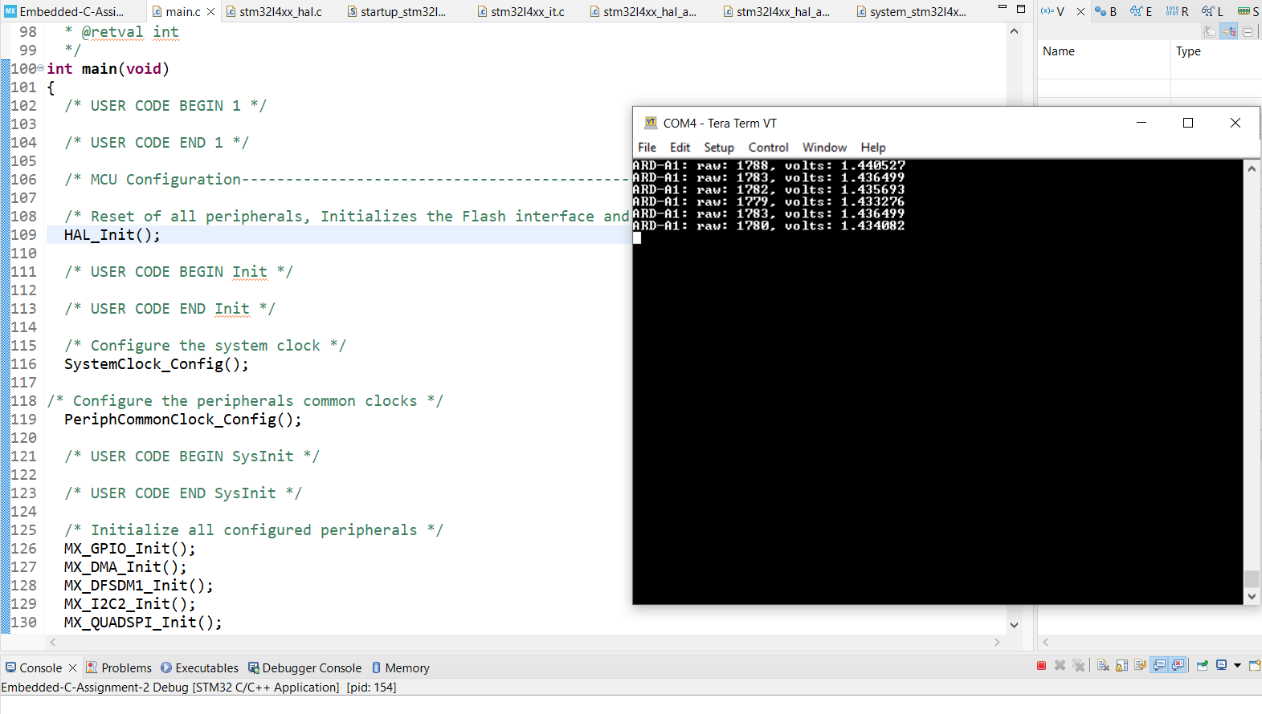
Step 19. Repeat user story 3, without calibration, we can see the result deviates more from 1.5V

Slide 21
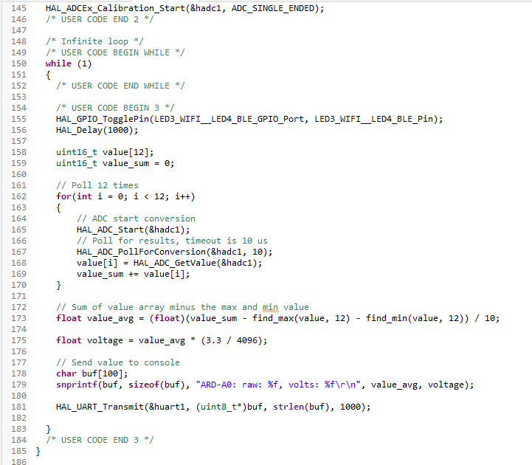
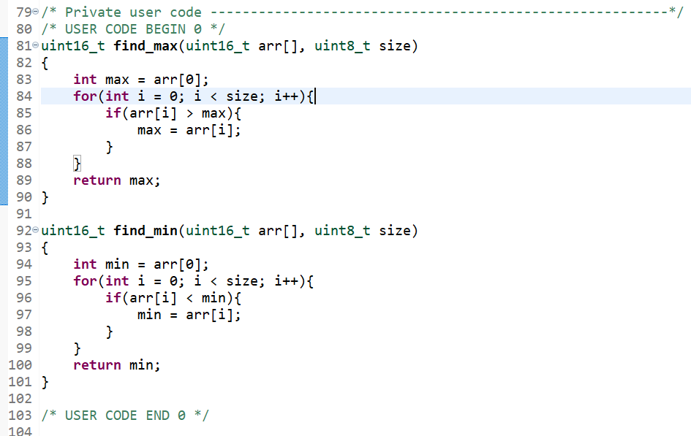
Step 20. User Store 5: Only for ADC Polling Mode, when it comes time to read, instead of reading a single time, read the ADC 12 times "back-to-back", dropping the smallest value and also the largest value

Slide 22
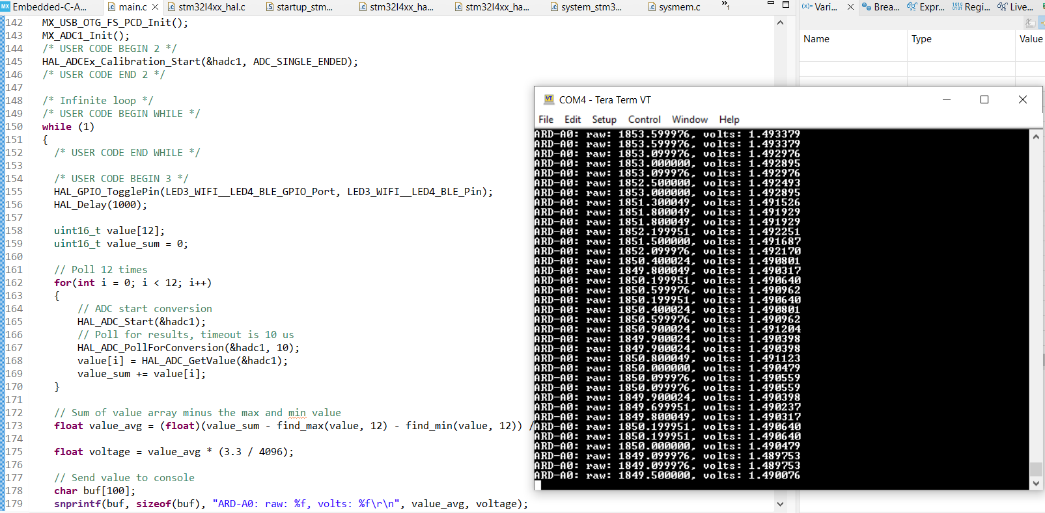
Step 21. User Store 6: Compare and contrast your output from User Story 1. I found out that the averaging method has more precise value compares to User Story 1, and the value does not jump around much.

Slide 23
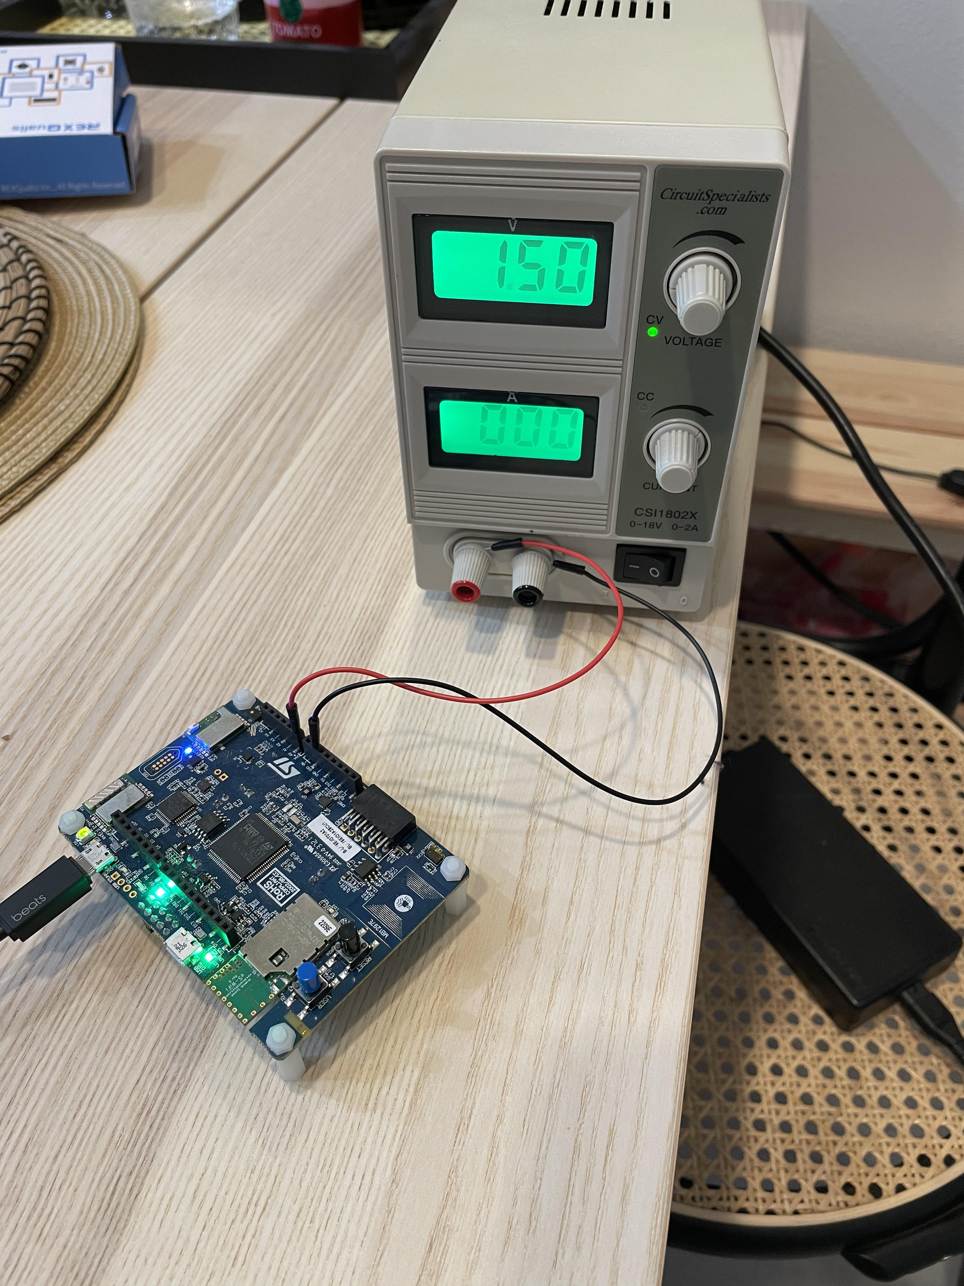
Appendix. Hardware connections

